Slide 1


Sales strategy for our new product
datacamp Practical Exam - Product Sales

Slide 2

What’s the suitable sales methods for our new product ?
Six weeks ago we launched a new line of office stationery.
We have tested three different sales strategies
Email
Customers in this group received an email when the product line was launched, and a further email three weeks later. This required very little work for the team.
Call
Customers in this group were called by a member of the sales team. On average members of the team were on the phone for around thirty minutes per customer.
Email and call
Customers in this group were first sent the product information email, then called a week later by the sales team to talk about their needs and how this new product may support their work. The email required little work from the team, the call was around ten minutes per customer.

Slide 3
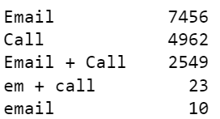
Data analysis overview
Data validation
Exploratory Analysis
Business Metric
15,000 customers
1,074 null entries in revenue
Data cleaning
The revenue spread and tendency over time.
Estimate the future revenue based on the current data.

Slide 4
How many customers were there for each approach?
Approach | Customer number
Call | 4,962
Email | 7,466
Email + Call | 2,572

Slide 5
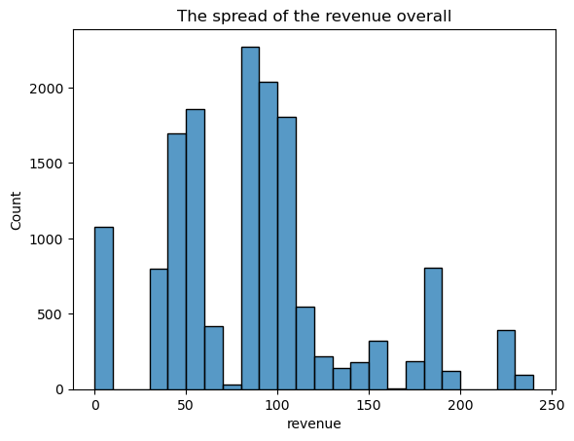
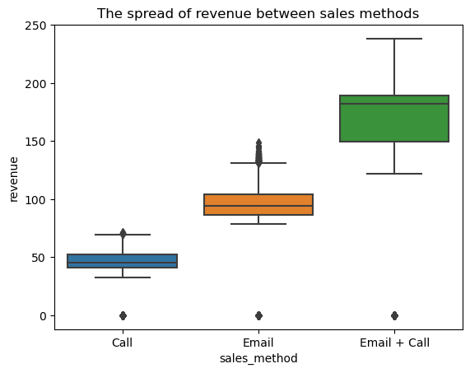
What does the spread of the revenue look like overall? And for each method?

Slide 6
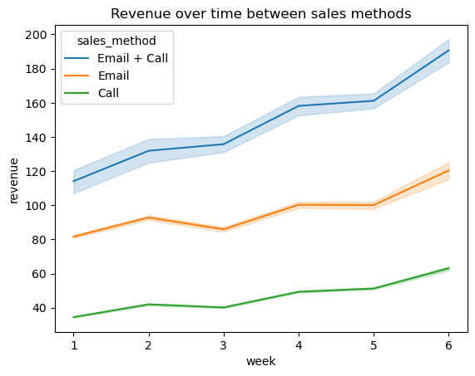
Was there any difference in revenue over time for each of the methods?

Slide 7
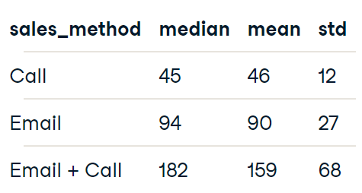
‘Email + Call’ method has the highest revenue. Therefore, it’s our best option based on the data.
We could use the medium of revenue as our business metric.
The expected revenue based on our data in 'Email + Call' group is 182 dollars.

Slide 8
Summary
Between three sales methods, 'Email + Call' is the best option because of the highest revenue.
For any sales methods, we have to wait until the sixth week for the best results.
'Call' is a time-consuming and low return method that should be avoid.
We could use the 'median of revenue' as business metric, the expected revenue for 'Email + Call' group is 182 dollars per customer. (assume there are no seasonal or other systemic influence variables)

